Slide 1






PRESENTATION 2026
AI-Powered Chatbots for Student Engagement and Academic Support
Mentor Name
Faculty Email
Faculty Name
Uma Maheshwari
bhattswaty@gmail.com
Swati Bhatt

Slide 2

Outline
Abstract of the Project
Problem Statement/Proposed Solution
System Architecture
Live Demo of the Project
Embedded Video of Project
Conclusion
Future Scope

Slide 3
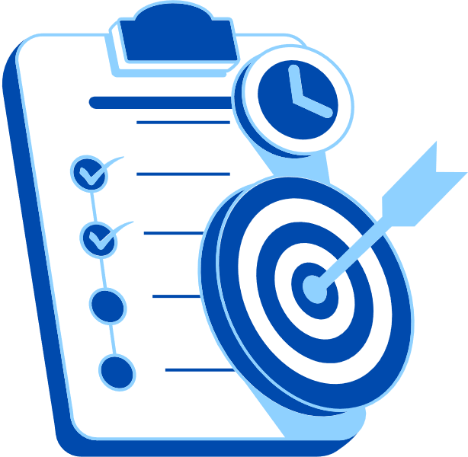
Abstract
This project explores the use of AI-powered chatbots to enhance student engagement and academic support. Traditional communication methods often delay responses and burden faculty with repetitive queries.
By leveraging the Microsoft Bot Framework, Copilot, Power BI, and NLP, the chatbot provides instant, personalized answers, collects real-time feedback, and enables sentiment analysis.
A structured five-phase methodology—requirement analysis, chatbot design, integration, analytics, and deployment—ensures scalability and institutional relevance.

Slide 4
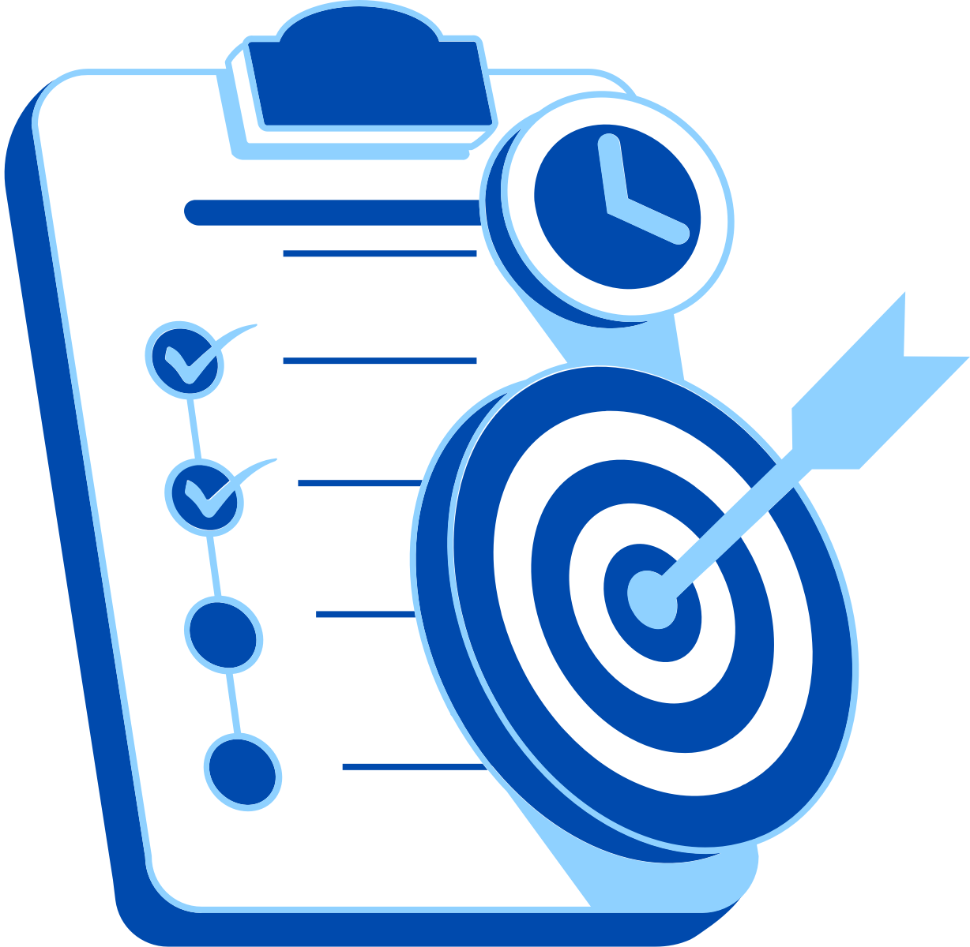
Abstract
Expected outcomes include improved communication efficiency, reduced faculty workload, and interactive dashboards for monitoring engagement trends.
An extension of this work applies chatbot technology to performance appraisal systems, streamlining HR workflows and fostering transparency.
Overall, the project demonstrates how conversational AI can transform educational and organizational processes through efficiency, inclusivity, and data-driven insights.

Slide 5
Objectives
• Design chatbot for academic and administrative queries.
• Integrate NLP for accurate responses.
• Enable real-time feedback and sentiment analysis.
• Connect chatbot outputs with Power BI dashboards.
• Create scalable deployment frameworks.k

Slide 6

Problem Statement
• Delays in responses to student queries
• Inefficiencies in traditional communication channels
• Faculty burden due to repetitive queries
• Need for structured chatbot deployment framework

Slide 7

Proposed Solution
1. Data Input / Source
Gather student queries from FAQs, LMS, feedback forms, and administrative records.
Connect chatbot to institutional systems via APIs for real-time data access.
Use simulated datasets for chatbot training and testing.
2. Processing / Analysis
Clean and standardize data to remove duplicates and ensure consistency.
Apply NLP to classify queries and perform sentiment analysis.
Transform text into structured insights for visualization.
3. AI / Tool Integration
Microsoft Bot Framework: Manages conversation flows.
Copilot: Enhances natural language understanding.
Power BI: Visualizes chatbot logs and engagement metrics.
NLP Libraries: Enable semantic and contextual analysis.
4. Output / Dashboard
**Chatbot Interface

Slide 8
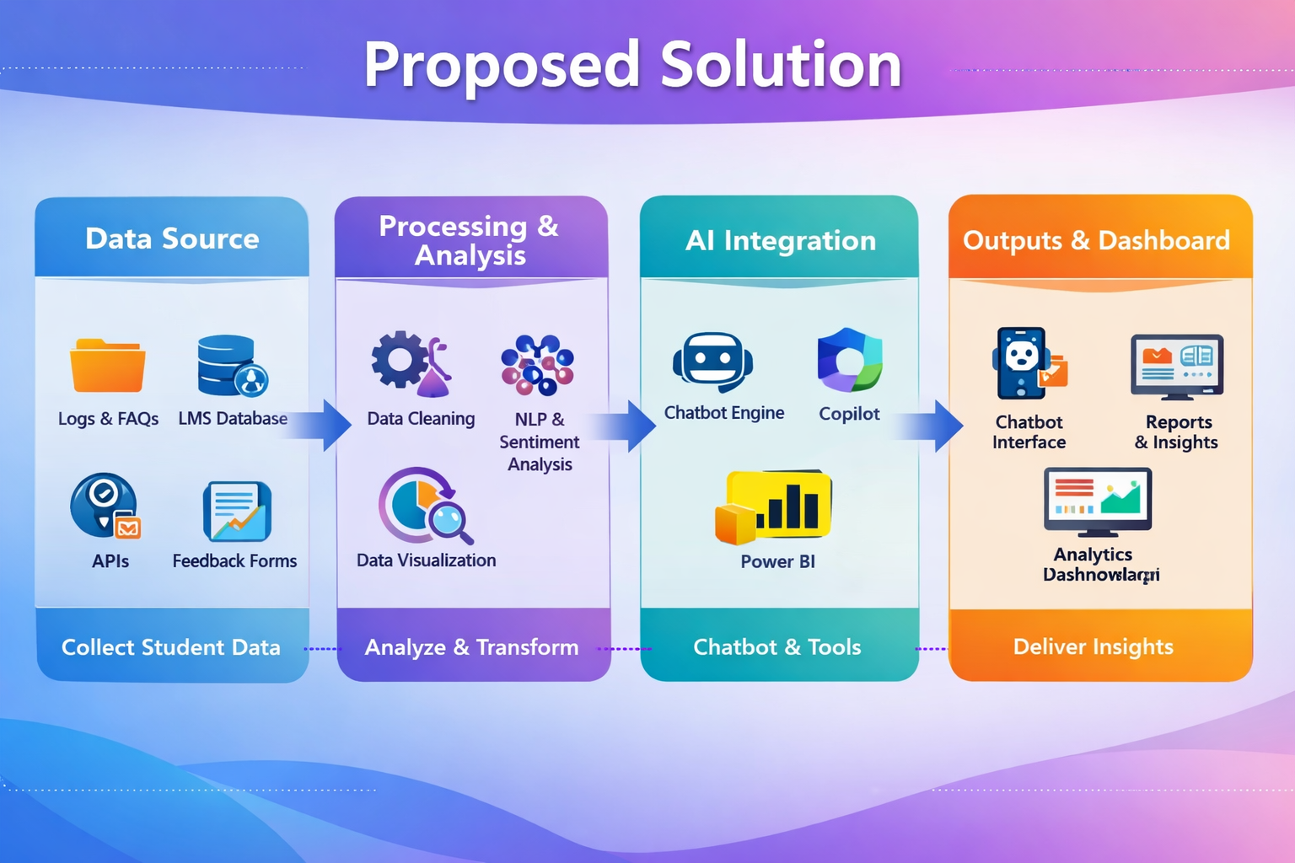

Slide 9
System Architecture
Data Input / Source
Processing / Analysis
Databases: Institutional LMS (Learning Management System) and administrative records.
APIs: Integration with Microsoft Bot Framework APIs for chatbot communication.
Uploads: Simulated datasets for chatbot training and testing.
- Data Cleaning: Remove duplicates, standardize query formats, and anonymize sensitive student information.
- Transformation: Convert raw text into structured intents and entities using NLP libraries.
- Analysis: Apply sentiment analysis and pattern recognition to identify common concerns and engagement trends.
- Tools: Power BI for visualization, Copilot for conversational flow refinement, and NLP models for language understanding.
AI / Tool Integration
Output / Dashboard
- Microsoft Bot Framework: Core chatbot engine for conversation flows and intent handling.
- Copilot: Enhances natural language responses and supports adaptive conversation design.
- Power BI: Connects chatbot logs to dashboards for real-time monitoring of engagement metrics.
- NLP Libraries: Enable semantic understanding, sentiment detection, and contextual response generation.
- Reports: Automated summaries of student queries and feedback trends.
- Charts: Visual representation of query categories, response times, and sentiment distribution.
- Dashboards: Interactive Power BI dashboards showing engagement metrics, faculty workload reduction, and student satisfaction indicators.
- Scalability: Framework adaptable across courses and departments for institutional deployment.

Slide 10
Live Demo of Project
Here's the list of some demo screenshots / features of the project:
Demo 1
Demo 2
Demo 3
[Add description of Demo 1 here — what this demo shows, key features, and results achieved.]
[Add description of Demo 2 here — what this demo shows, key features, and results achieved.]
[Add description of Demo 3 here — what this demo shows, key features, and results achieved.]

Slide 11
Video of Project Demo
[https://your-project-demo-link.com]
▶
[Insert your project demo video.
You can embed a video your live project.]

Slide 12

Conclusion
The proposed AI-powered chatbot offers a structured, scalable solution to improve student engagement and academic support. By integrating Microsoft Bot Framework, Copilot, Power BI, and NLP libraries, the system ensures instant query resolution, real-time feedback collection, and actionable insights through interactive dashboards.
This reduces repetitive faculty workload, enhances communication efficiency, and empowers institutions with data-driven decision-making.
Beyond education, the extension into performance appraisal systems highlights the broader applicability of conversational AI in streamlining workflows, fostering transparency, and supporting continuous improvement.
Overall, the project demonstrates how AI-driven chatbots can transform traditional processes into efficient, inclusive, and intelligent systems.
CONCLUSION

Slide 13

Future Scope
1. Feature Enhancements
- Incorporate voice-enabled chatbot interactions for accessibility and inclusivity.
- Add multilingual support to cater to diverse student populations.
- Enable predictive analytics to anticipate student needs and proactively suggest resources.
2. Scalability Plans
- Expand deployment across multiple courses, departments, and institutions.
- Integrate chatbot services into mobile apps and learning platforms for wider reach.
- Support cloud-based hosting for seamless scaling and performance optimization.

Slide 14
3. Integration Possibilities
- Connect with Learning Management Systems (LMS) for real-time academic updates.
- Link with HR and performance management systems for appraisal workflows.
- Integrate with social media platforms to enhance student engagement outside classrooms.
4. Further Research Areas
- Explore AI ethics and data privacy frameworks for secure chatbot interactions.
- Study student behavioral analytics to improve personalization.
- Investigate AI-driven adaptive learning models that tailor content based on student progress.

Slide 15
Thank You
AICW Fellowship | Student Project Presentation 2026
LinkedIn | Edunet Foundation

